Slide 1





Top layer/text
Sep 22, 2023
Episode Details
User Spotlight! Cloud Underground
tv ‘noise’

Slide 2

Top layer/text
Sep 15, 2023
Episode Details
User Spotlight! ztsolutions.io
tv ‘noise’

Slide 3

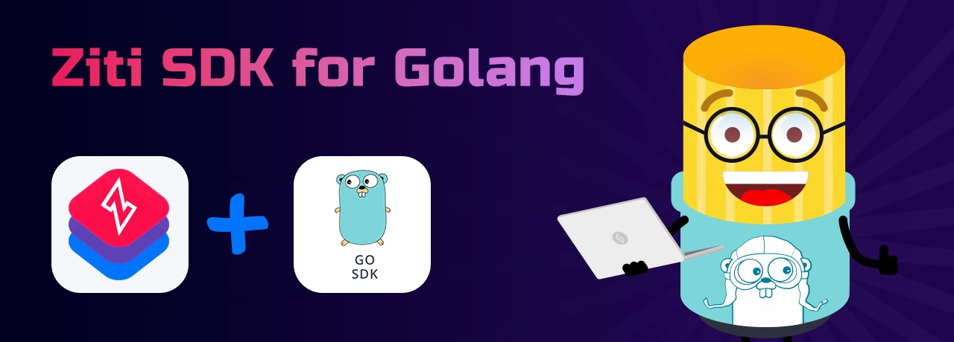
Sep 08, 2023
Episode Details
Automating OpenZiti and using the Golang SDK

Slide 4

Top layer/text
Sep 01, 2023
Episode Details
Link Groups!
tv ‘noise’

Slide 5

Top layer/text
Aug 25, 2023
Episode Details
User Spotlight! NetFoundry?!?!
tv ‘noise’

Slide 6
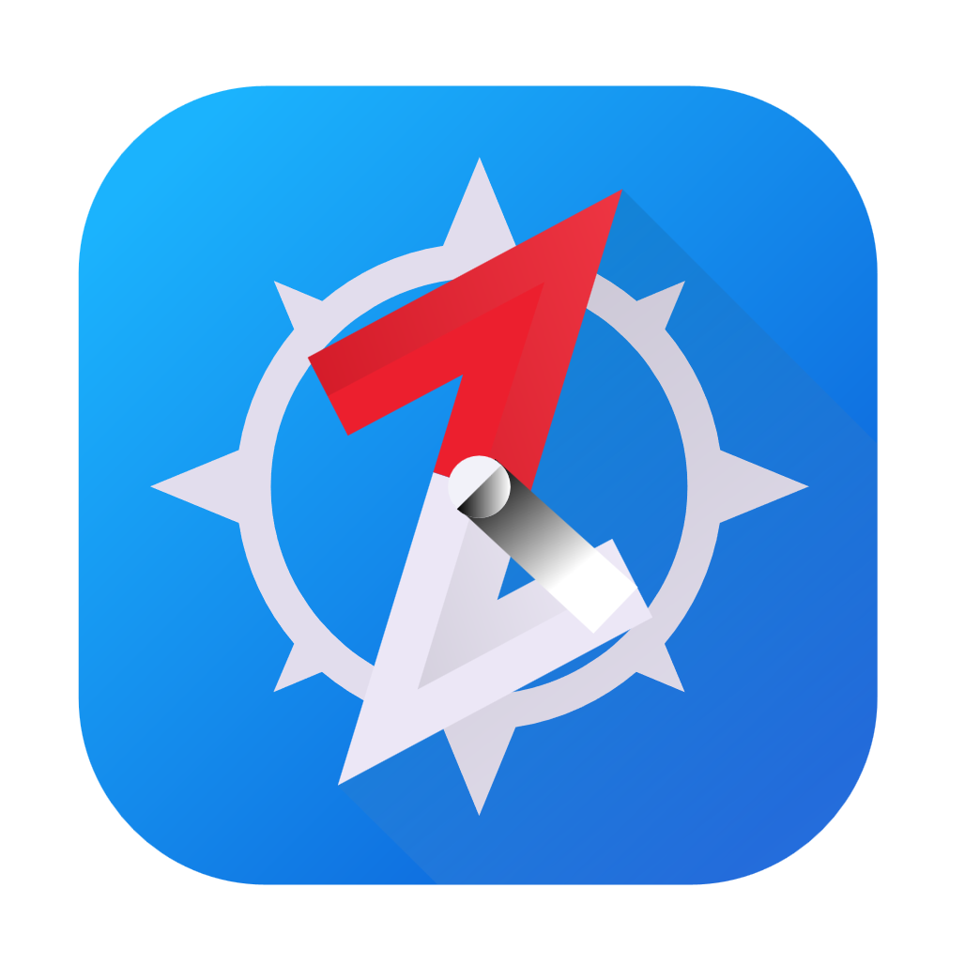
Aug 18, 2023
Episode Details
Let’s self-host BrowZer! (again)

Slide 7


Aug 4, 2023
Episode Details
zrok public beta!!!

Slide 8


Jul 21, 2023
Episode Details
Study Time
OpenZiti Overview!

Slide 9
What is Zero Trust
WHY Zero Trust
Anatomy of the overlay
Controller
Router
Tunnelers/clients/SDK
What’s a/an:
Service
Config
Service Policy
Identity
Study Time

Slide 10

Jul 14, 2023
Episode Details
User Spotlight! Analytics HQ!

Slide 11
Jun 23, 2023
Episode Details
Let’s self-host BrowZer!

Slide 12

Jun 23, 2023
Episode Details
User Spotlight! Paul Otto - RAFT

Slide 13
Jun 09, 2023
Episode Details
Just how DOES BrowZer work???

Slide 14
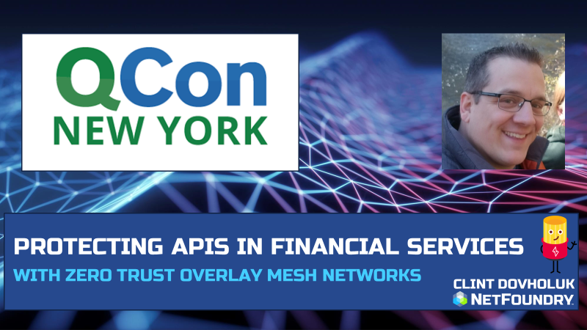
Jun 02, 2023
Episode Details
Securing APIs with OpenZiti and SPIRE! Application Embedded Zero Trust!

Slide 15
May 26, 2023
Episode Details
Office Hours and livestream

Slide 16


ZSSH with oidc!

Slide 17

Edgex Foundry + OpenZiti

Slide 18
Apr 28, 2023
Episode Details
Adding OpenZiti to microservice sample code

Slide 19


Apr 14, 2023
Episode Details
Even more zrok!!!
zrok in docker?
zrok in Kubernetes!?

Slide 20
Mar 31, 2023
Episode Details
OIDC, Keycloak, IdP, ext-jwt-signers

Slide 21
Mar 17, 2023
Episode Details
Working session: OpenZiti Network in Kubernetes!

Slide 22
Mar 10, 2023
Episode Details
Qcon 2023 Presentation

Slide 23

Mar 03, 2023
Episode Details
Monthly Forum

Slide 24
Feb 17, 2023
Episode Details
Release note read out
zrok in docker
zrok in Kubernetes!?

Slide 27


Slide 29
Feb 17, 2023
Episode Details
Release note read out
zrok in docker
zrok in Kubernetes!?

Slide 30

Feb 10, 2023
Episode Details
User Spotlight!

Slide 31
Feb 3, 2023
Episode Details
New container images!?

Slide 32
Jan 18, 2023
Episode Details
Javier Diaz from Jeju National University. Blockchain, OpenZiti and Intent-based networking

Slide 33
Dec 9, 2022
Episode Details
Release Notes:
0.21.11
Zitification – Beats!
SERPs

Slide 34
Jan 12, 2023
Episode Details
Monthly Ideas Forum

Slide 35


Nov 18, 2022
Episode Details
Release Notes:
0.26.11+
+

Slide 36
Nov 11, 2022
Episode Details
Release Notes:
0.26.11+
Looking at samples

Slide 37
Nov 04, 2022
Episode Details
Release Notes:
0.26.10+
BrowZer!!!

Slide 38
Oct 28, 2022
Episode Details
Release Notes:
0.26.10+
Working Session!

Slide 39
Oct 21, 2022
Episode Details
Release Notes:
0.26.10+
Config types – take 2!

Slide 40
Oct 07, 2022
Episode Details
Release Notes:
0.26.9+
Config types!

Slide 41
Sep 23, 2022
Episode Details
Release Notes:
0.26.8+
Linux UI/Packaging
Python SDK
Hacker News postings
other?

Slide 42
Sep 16, 2022
Release Notes:
0.26.5+
Multi-Region APIs with Kubernetes
Episode Details

Slide 43
Sep 09, 2022
Release Notes:
0.26.4+
VPN vs Zero Trust
User Experience
Episode Details

Slide 44
Sep 02, 2022
Release Notes:
0.26.4+
New ZDEW UI?
Episode Details

Slide 45
Aug 26, 2022
Release Notes:
0.26.4+
Custom PKI with OpenSSL?
Episode Details

Slide 46
Aug 12, 2022
Release Notes:
0.26.4+
CVE’s, Lambdas and OpenZiggy
Episode Details

Slide 47
Aug 05, 2022
Release Notes:
0.26.4+
ziti CLI and debugging
Episode Details

Slide 48
July 22, 2022
Release Notes:
0.26.2+
Application Embedded LDAP Client
Episode Details

Slide 49
July 15, 2022
Release Notes:
0.26.1+
Posture Checks
Episode Details

Slide 50
July 08, 2022
Release Notes:
0.26.1+
What is ‘zitify’?
Episode Details

Slide 51
July 01, 2022
Release Notes:
0.26.0+
Making ZAC and the Management API DARK!
Episode Details

Slide 52
June 17, 2022
Release Notes:
0.25.12+
Zitifying Ansible!?!?!
Episode Details

Slide 53
June 10, 2022
Release Notes:
0.25.11+
Python support and other SDK conversation
Episode Details

Slide 54
June 3, 2022
Release Notes:
None
Replacing SSH bastions with OpenZiti
Episode Details

Slide 55

June 3, 2022
Release Notes:
None
Replacing SSH bastions with OpenZiti
Episode Details

